Slide 1

BARTSeq Mk4

Slide 2
Previous state
Many hands touched the pipeline
Versions for multiple (arising) challenges
“Collection-of-scripts” approach

Slide 3
One to rule them all?
Unified approaches from all pipelines
Most generic (E.g. No amplicon merging)
Workflow manager: Snakemake
  GUI
  Make-like timestamps (only do the necessary)
  Simple and clear rules, visualizable

Slide 4
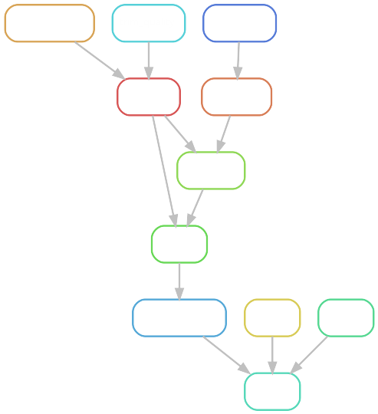
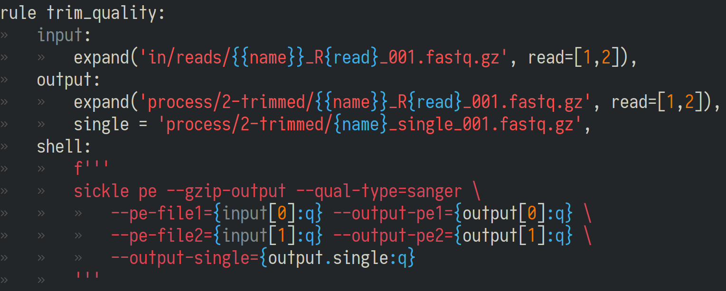
Snakemake

Slide 5
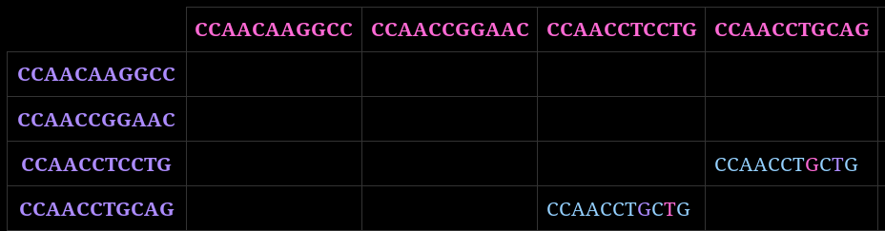
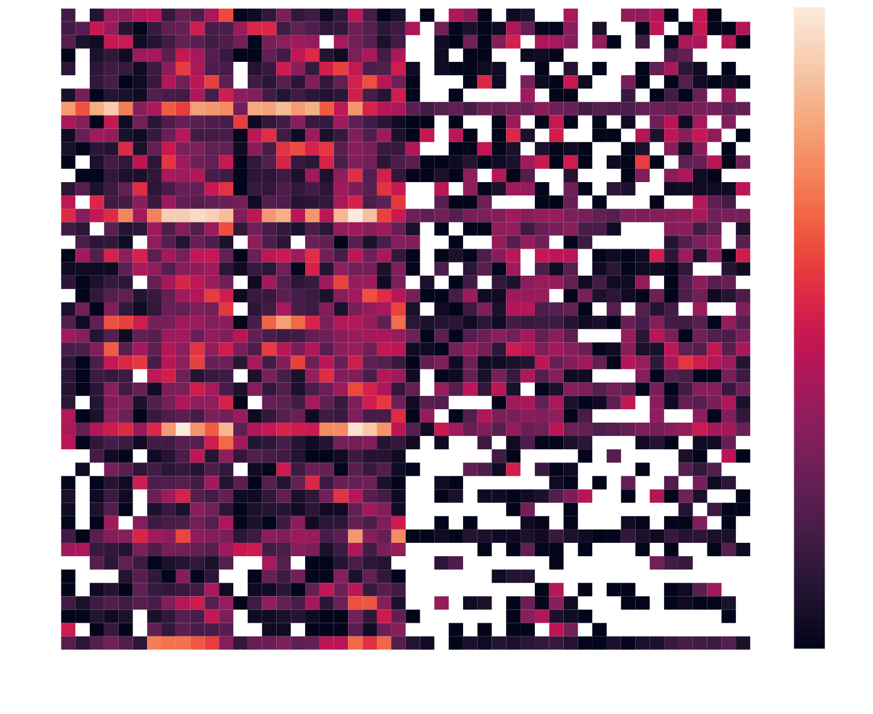
Other goodies
Quality control output
Barcode search
with mismatch info
Heatmaps for
all amplicons
Statistics
(see next slide)

Slide 6
Results: NGS15
 | Read 1 | Read 2
only_primer | 4.2% | 4.5%
multiple_bcs | 15.8% | 18.3%
no_barcode | 18.4% | 17.5%
Regular | 77.5% | 78.0%
barcode_mismatch | 10.5% | 6.2%
Junk | 5.6% | 5.9%
# Reads: 36810551
Both regular: 62.0%

Slide 7
Results: NGS23
 | Read 1 | Read 2
only_primer | 2.1% | 1.0%
multiple_bcs | 8.8% | 10.3%
no_barcode | 21.8% | 22.3%
Regular | 76.1% | 76.7%
barcode_mismatch | 2.5% | 3.4%
Junk | 3.8% | 4.1%
# Reads: 10410665
Both regular: 57.1%

Slide 8
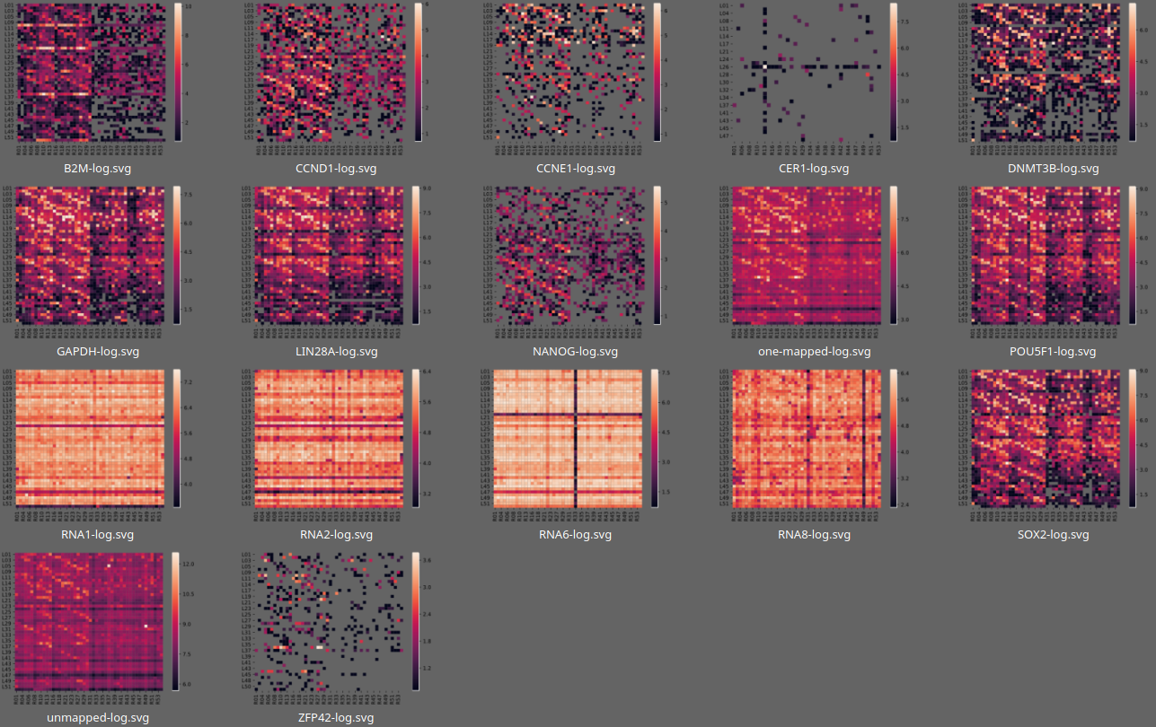
Expression NGS15

Slide 9
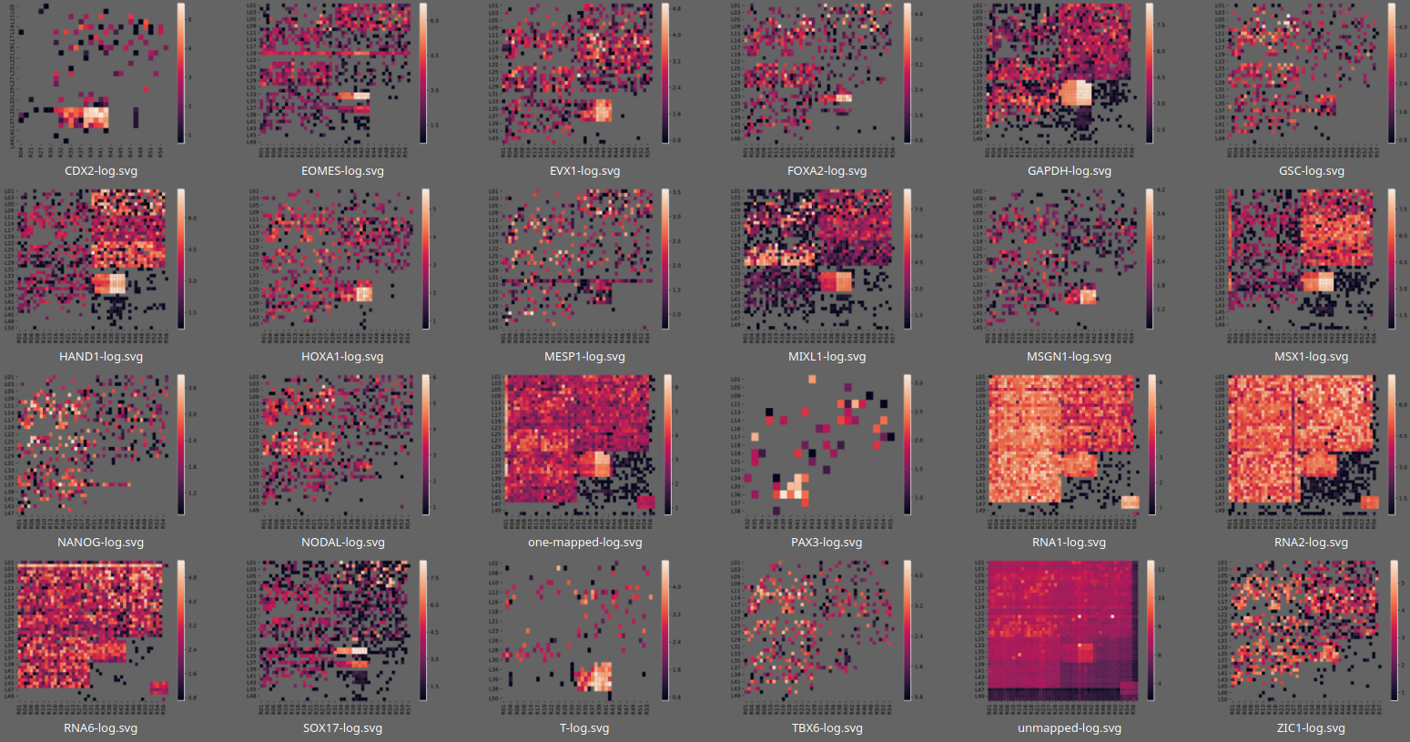
Expression NGS23

Slide 10
More
Thank you for listening!
Analyses you always want done?
More stats you’d like to know?

Slide 11
More
Thank you for listening!
Analyses you always want done?
More stats you’d like to know?

